Slide 1
Relational Database for the Environmental Investigation Agency
By: Anish Gupta

Slide 2
Mission Statement
The purpose of the Global Environmental Crime Tracker database is to maintain the data the Environmental Investigation Agency (EIA) uses to track environmental crimes and abuse around the world so that they can campaign for improved governance and more effective enforcement of environmental laws.

Slide 3
Mission Objectives
At present EIA does not have a relational database
An RDBMS would be very helpful in:
Tracking environmental crimes
Getting crime country information
The type of crime
Information on seizure
Any endangered animals involved
Details of the criminals
Punishment received by the criminals
Useful for generating reports and performing analysis

Slide 4
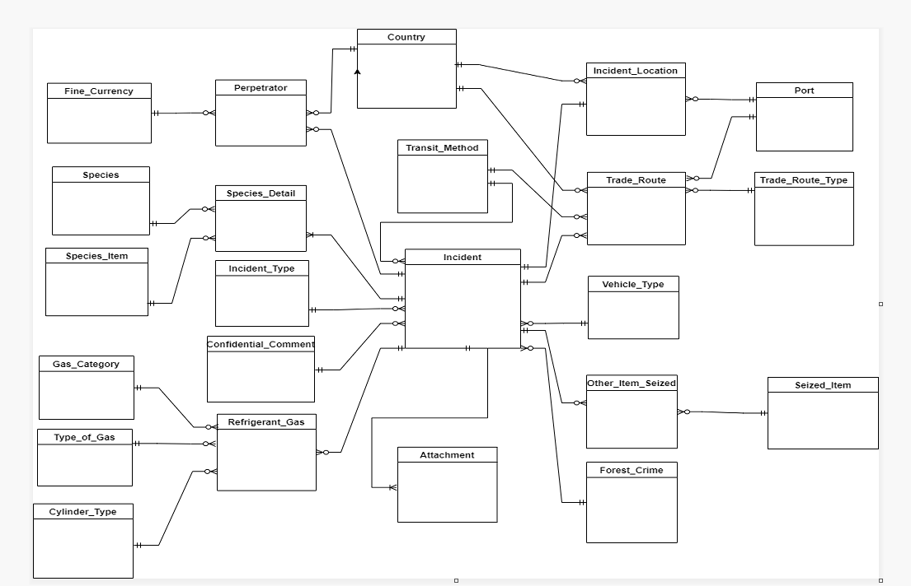
Diagram of tables/relationships
Crow’s Foot Diagram for the Global Environmental Crime Tracker Database

Slide 5
Sample question -
What environmental crimes have been committed, in which countries have the crimes taken place, have any endangered species been harmed in the process and have the perpetrators of the crimes been arrested and convicted?

Slide 6
SQL to solve the Sample Question
SELECT DISTINCT Incident.Incident_ID, Incident_Type, Seizure_Date, Country_Name, Species, Perpetrator_ID, Full_Name, Arrested, Conviction
FROM Incident
INNER JOIN Incident_Type ON Incident.Incident_Type_ID = Incident_Type.Incident_Type_ID
INNER JOIN Location ON Incident.Incident_ID = Location.Incident_ID
LEFT JOIN Species_Detail ON Incident.Incident_ID = Species_Detail.Incident_ID
LEFT JOIN Perpetrator ON Incident.Incident_ID = Perpetrator.Incident_ID
INNER JOIN Country ON Location.Country_ID = Country.Country_ID
INNER JOIN Species ON Species_Detail.Species_ID = Species.Species_ID
ORDER BY Incident.Incident_ID;

Slide 7
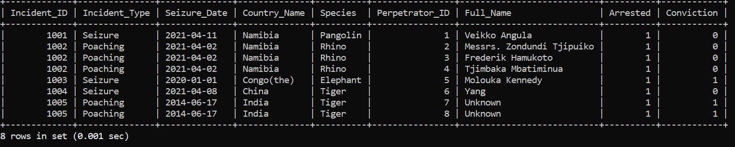
Result set

Slide 8
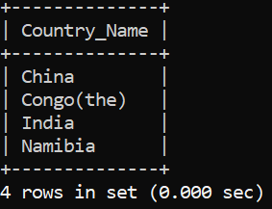
Basic query
List of countries where the environmental crimes are being committed:
SELECT DISTINCT Country_Name
FROM Incident,Location,Country
WHERE Incident.Incident_ID = Location.Incident_ID AND Location.Country_ID = Country.Country_ID
ORDER BY Country_Name;

Slide 9
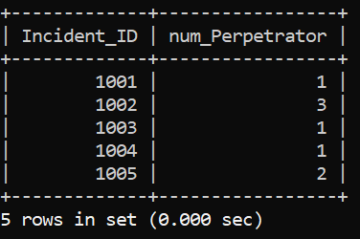
Aggregate query
SELECT Incident.Incident_ID,
COUNT(Perpetrator.Perpetrator_ID) AS num_Perpetrator
FROM Incident
LEFT JOIN Perpetrator ON Incident.Incident_ID = Perpetrator.Incident_ID
GROUP BY Incident.Incident_ID;

Slide 10
Multi-table join
This is a Multi-table join joining Incident with other data tables like Location, Species_Detail, Perpetrator, Trade_Route, Other_Item_Seized, Refrigerant_Gas, and related lookup tables.
SELECT DISTINCT Incident.Incident_ID, Incident_Type, Seizure_Date, C1.Country_Name, Species, Perpetrator_ID, Full_Name, Arrested, Conviction,Trade_Route_ID,Trade_Route_Type,C2.Country_Name AS Trade_Route_Country,Trade_Route.Location AS Trade_Route_Location,Comments AS Trade_Route_Comments,Travel_Date, Seized_Item, OS.Quantity, Description AS Trade_Route_Description, Gas_Category, Type_of_Gas, Cylinder_Type, Number_of_Cylinders, RG.Additional_Description AS Refrigerant_Gas_Description
FROM Incident
INNER JOIN Incident_Type ON Incident.Incident_Type_ID = Incident_Type.Incident_Type_ID
INNER JOIN Location ON Incident.Incident_ID = Location.Incident_ID
INNER JOIN Country C1 ON Location.Country_ID = C1.Country_ID
INNER JOIN Species_Detail ON Incident.Incident_ID = Species_Detail.Incident_ID
INNER JOIN Species ON Species_Detail.Species_ID = Species.Species_ID
LEFT JOIN Perpetrator ON Incident.Incident_ID = Perpetrator.Incident_ID
LEFT JOIN Trade_Route ON Incident.Incident_ID = Trade_Route.Incident_ID
LEFT JOIN Trade_Route_Type ON Trade_Route.Trade_Route_Type_ID = Trade_Route_Type.Trade_Route_Type_ID
LEFT JOIN Port ON Trade_Route.Port_ID = Port.Port_ID
LEFT JOIN Transit_Method ON Trade_Route.Transit_Method_ID = Transit_Method.Transit_Method_ID
LEFT JOIN Country C2 ON Trade_Route.Country_ID = C2.Country_ID
LEFT JOIN Other_Item_Seized OS ON Incident.Incident_ID = OS.Incident_ID
LEFT JOIN Seized_Item ON OS.Seized_Item_ID = Seized_Item.Seized_Item_ID
LEFT JOIN Refrigerant_Gas RG ON Incident.Incident_ID = RG.Incident_ID
LEFT JOIN Gas_Category ON RG.Gas_Category_ID = Gas_Category.Gas_Category_ID
LEFT JOIN Type_of_Gas ON RG.Type_of_Gas_ID = Type_of_Gas.Type_of_Gas_ID
LEFT JOIN Cylinder_Type ON RG.Cylinder_Type_ID = Cylinder_Type.Cylinder_Type_ID;

Slide 11
View
This view gives a list with details of the Environmental Crimes.
CREATE VIEW Environmental_Crimes AS
SELECT DISTINCT Incident.Incident_ID, Incident_Name, Incident_Type, Seizure_Date, C1.Country_Name, Species, Perpetrator_ID, Full_Name, Arrested, Conviction,
Trade_Route_ID,Trade_Route_Type,C2.Country_Name AS Trade_Route_Country,Port,Trade_Route.Location,Transit_Method,Comments,Travel_Date
FROM Incident
INNER JOIN Incident_Type ON Incident.Incident_Type_ID = Incident_Type.Incident_Type_ID
INNER JOIN Location ON Incident.Incident_ID = Location.Incident_ID
INNER JOIN Country C1 ON Location.Country_ID = C1.Country_ID
LEFT JOIN Species_Detail ON Incident.Incident_ID = Species_Detail.Incident_ID
LEFT JOIN Species ON Species_Detail.Species_ID = Species.Species_ID
LEFT JOIN Perpetrator ON Incident.Incident_ID = Perpetrator.Incident_ID
LEFT JOIN Trade_Route ON Incident.Incident_ID = Trade_Route.Incident_ID
LEFT JOIN Trade_Route_Type ON Trade_Route.Trade_Route_Type_ID = Trade_Route_Type.Trade_Route_Type_ID
LEFT JOIN Port ON Trade_Route.Port_ID = Port.Port_ID
LEFT JOIN Transit_Method ON Trade_Route.Transit_Method_ID = Transit_Method.Transit_Method_ID
LEFT JOIN Country C2 ON Trade_Route.Country_ID = C2.Country_ID;

Slide 12
Stored Procedure
This procedure is used to get a list of Environmental Crimes committed against a particular species.
CREATE PROCEDURE One_Species_Crime (IN search_species VARCHAR(100))
BEGIN
SELECT DISTINCT Incident.Incident_ID, Incident_Type, Seizure_Date, C1.Country_Name, Species, Perpetrator_ID, Full_Name, Arrested, Conviction,
Trade_Route_ID,Trade_Route_Type,C2.Country_Name AS Trade_Route_Country,Port,Trade_Route.Location,Transit_Method,Comments,Travel_Date
FROM Incident
INNER JOIN Incident_Type ON Incident.Incident_Type_ID = Incident_Type.Incident_Type_ID
INNER JOIN Location ON Incident.Incident_ID = Location.Incident_ID
INNER JOIN Country C1 ON Location.Country_ID = C1.Country_ID
INNER JOIN Species_Detail ON Incident.Incident_ID = Species_Detail.Incident_ID
INNER JOIN Species ON Species_Detail.Species_ID = Species.Species_ID
LEFT JOIN Perpetrator ON Incident.Incident_ID = Perpetrator.Incident_ID
LEFT JOIN Trade_Route ON Incident.Incident_ID = Trade_Route.Incident_ID
LEFT JOIN Trade_Route_Type ON Trade_Route.Trade_Route_Type_ID = Trade_Route_Type.Trade_Route_Type_ID
LEFT JOIN Port ON Trade_Route.Port_ID = Port.Port_ID
LEFT JOIN Transit_Method ON Trade_Route.Transit_Method_ID = Transit_Method.Transit_Method_ID
LEFT JOIN Country C2 ON Trade_Route.Country_ID = C2.Country_ID
WHERE Species = search_species;
END//
CALL One_Species_Crime("Tiger")
CALL One_Species_Crime("Rhino")

Slide 13
Future directions for development
Store PDF files in the column Attachment in the Attachment table
Use the stored procedure to calculate the Longitude and Latitude information based on city and country information using Google Map’s API or a similar API

